Slide 1


Microprocessors and Assembly Language Spring 2020
Hamed Farbeh
farbeh@aut.ac.ir
Department of Computer Engineering
Amirkabir University of Technology
Lecture 21

Slide 2
Copyright Notice
Parts (text & figures) of this lecture are adopted from:
Arm Assembly Language Programming and Architecture, Volume 1, 1st edition, Muhammad Ali Mazidi, Sarmad Naimi, and Sepehr Naimi, MicroDigitalEd, 2013.
Microprocessors and Assembly Language, Spring 2020, AUT, Tehran, Iran

Slide 3
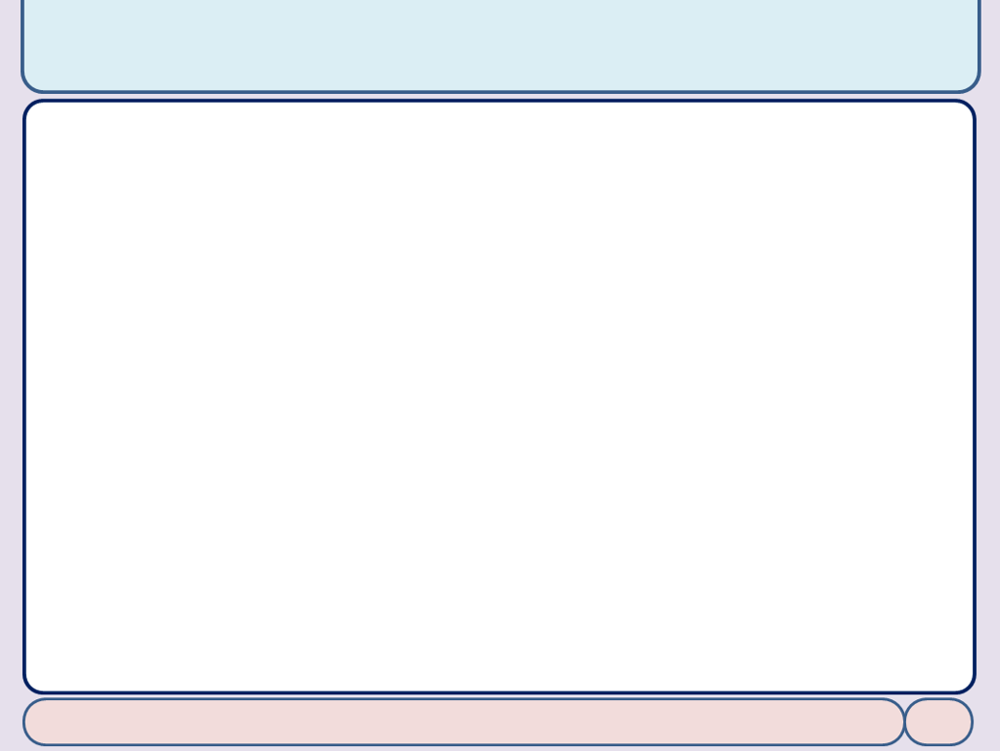
Signed Integer Numbers Arithmetic
Microprocessors and Assembly Language, Spring 2020, AUT, Tehran, Iran

Slide 4
Signed number
Sign extension and avoiding erroneous results
; assume memory location 0x80000 has +96 = 0110 0000 and R1=0x80000
LDRSB R0, [R1] ; now R0 = 00000000000000000000000001100000
; assume memory location 0x80000 contains -2 = 1111 1110 and R2=0x80000
LDRSB R4, [R2] ; now R4 = 11111111111111111111111111111110
; assume 0x80000 contains +260 = 0000 0001 0000 0100 and R1=0x80000
LDRSH R0, [R1] ; R0=0000 0000 0000 0000 0000 0001 0000 0100
; assume location 0x20000 has -327660=0x8002 and R2=0x20000
LDRSH R1, [R2] ; R1=FFFF8002
Microprocessors and Assembly Language, Spring 2020, AUT, Tehran, Iran

Slide 5
Signed number
Signed number multiplication: SMULL
LDR R1, =-3500 ; R1 = -3500 (0xFFFFF254)
LDR R0, =-100 ; R0 = -100 (0xFFFFFF9C)
SMULL R2, R3, R0, R1
Signed number comparison
CMP Rn, Op2
Op2 > Rn V = N Op2 = Rn Z = 1 Op2 < Rn N ≠ V
Microprocessors and Assembly Language, Spring 2020, AUT, Tehran, Iran

Slide 6
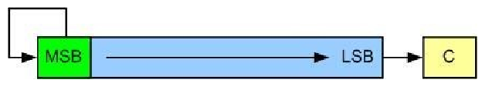
Arithmetic Shift
ASR (arithmetic shift right)
MOV Rn, Op2, ASR count
or
ASR Rn, Op2, count
Microprocessors and Assembly Language, Spring 2020, AUT, Tehran, Iran

Slide 7
End of Chapter 5!
Microprocessors and Assembly Language, Spring 2020, AUT, Tehran, Iran

